Slide 1
Practice #5
Create Performance Task

Slide 2

AP CSP Create Performance Task
Part of the AP Exam is to create a program that meets specific requirements:
Creates a list
Uses a list in a meaningful way
Has a function with a parameter
  Parameter affects function execution
Function has:
  If statement
  Loop

Slide 3
AP CSP Create Performance Task
Things to know about the Create PT:
You can work with a partner
Your classmates can help you
Your teacher cannot help you
You cannot use an assigned program for your project, but it can be similar
You will be given 9 hours of class time to work on the project

Slide 4
AP CSP Create Performance Task
The Create PT is like a remix project:
Start small and add components.
Start with what you know.
Don’t try something new that you don’t know how to do.
This isn’t a time to learn something new, but to show what you know how to do.

Slide 5
AP CSP Create Performance Task
The Create PT is like a remix project:
During a remix, you looked at completed programs and reviewed what you learned.
You either added to or created a program similar to your completed programs.
You can do the same thing for the Create PT.
Let’s look at a program from a mission and remix it to meet the requirements of the Create PT.

Slide 6
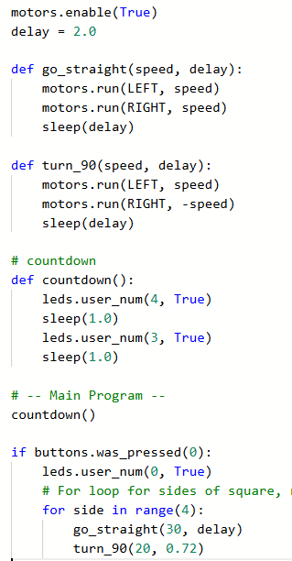
Practice #3
In CodeSpace, go to the Sandbox.
Open the project: WhatIf_loops
Go to File Save As… and rename the file PT_CodeBot_Practice3
What PT requirements does it meet?
What PT requirements does it lack?

Slide 7


Practice #3
PT Requirements
Creates a list
Uses a list in a meaningful way
Has a function with a parameter
  Parameter affects function execution
Function has:
  If statement
  Loop

Slide 8
Practice #3
This project barely meets one requirement.
But can you add code to it to meet the requirements?
Go to the Activity Guide and write down some possible program modifications.

Slide 9
Practice #3
On slide 4, it says
“Don’t try something new that you don’t know how to do.”
For this practice lesson, you are going to do something new.
You are going to use a list of lists, which is also called a matrix.
Do your best. If this lesson is confusing, just remember that you don’t have to use a matrix in your Create PT project.

Slide 10
Practice #3
Let’s start by creating a list.
Notice that the functions turn_90() and go_straight() are almost the same.
The only difference is using a negative speed in turn_90(), and a different delay.
Create a list of lists (matrix) that uses this information.
This list will draw one side and one turn.
The data comes from the go_straight() and turn_90() function calls.

Slide 11

Practice #3
Create a matrix: a list of lists.
Add more elements to the list to make a full square with four sides.

Slide 12
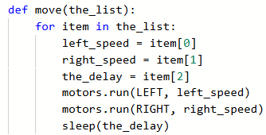
Practice #3
Modify the go_straight() function to traverse the list.
Change the name.
Traverse the list by item.
Each item in the list is another list.
You need to extract the information from the list.
Then use the extracted data.
Delete the turn_90() function.

Slide 13
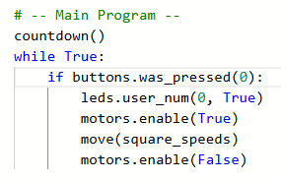

Practice #3
Change the main program for testing.

Slide 14
Practice #3
Revisit the PT Requirements:
Creates a list
Uses a list in a meaningful way
Has a function with a parameter
  Parameter affects function execution
Function has:
  If statement
  Loop

Slide 15
Practice #3
Now most of the Create PT requirements are met.
How can you add an if statement to the move() function?
There are many ways.
One way is to add a second list for a different shape.
In this example, the shape will be a square made with left turns instead of right turns.

Slide 16
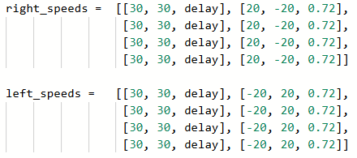
Practice #3
Add a second list for a second shape.

Slide 17
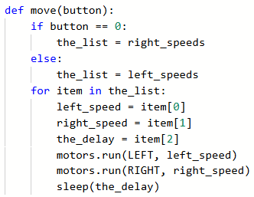
Practice #3
Change the parameter in the function, for the button pressed.
Use the parameter in an if statement to assign the list.

Slide 18
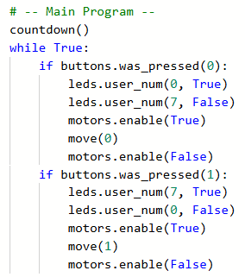
Practice #3
Complete the main program for two button presses.

Slide 19
Practice #3
Revisit the PT Requirements:
Creates a list
Uses a list in a meaningful way
Has a function with a parameter
  Parameter affects function execution
Function has:
  If statement
  Loop

Slide 20
Practice #3
Now that you have seen an example of a remix from the WhatIf program, can you think of any other ways to remix the project for the Create PT?
Go to the Activity Guide and write down any more ideas you have for modifications.

Slide 21
Practice #3
Final considerations.
Your program needs to have input and output.
  Be prepared to explain the input and output of this program.
  This program has input through button presses.
  In a video, you want to show the button presses, or add a caption that explains the input
  The output is the lit LEDs and the CodeBot moving in a square.
  In a video, you want to show the movement and LEDs.

Slide 22
Final considerations.
Your program needs to have a specific purpose and intended user.
  The purpose of this program could be explained as a learning tool for children to help them learn left and right.
  The function is to draw a square turning left or right.
  The intended user is a young child who want to use a physical device to learn left and right.

Slide 23
Practice #3
Final considerations.
You need to explain how the lists manage complexity.
  It looks like the lists just have repeated data, so someone could question why you don’t just use a loop.
  The lists allow you to change the shape easily, without having to go in the code to do it. For example, if you want a triangle instead of a square, you just change the data in the list.
  Of if you want a smaller square, you just change the delay in the list.
  Think of ways the list helps you manage complexity in this project.

